Slide 1
Nettleham Parish Council
Annual Parish Meeting
Nettleham Neighbourhood Plan
2024 Update

Slide 2
What is a Neighbourhood Plan?
Nettleham Neighbourhood Plans
The NNP Review Process
Public Consultation
Nettleham Issues
Current situation
Future & Adoption

Slide 3
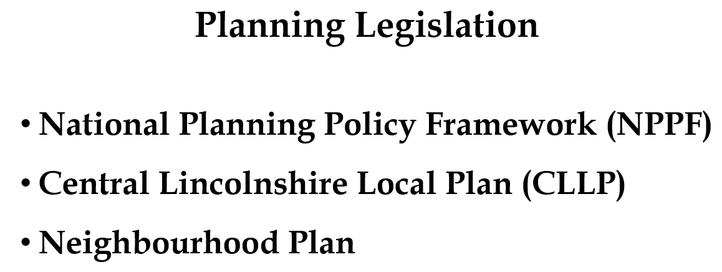
What is a Neighbourhood Plan?

Slide 4
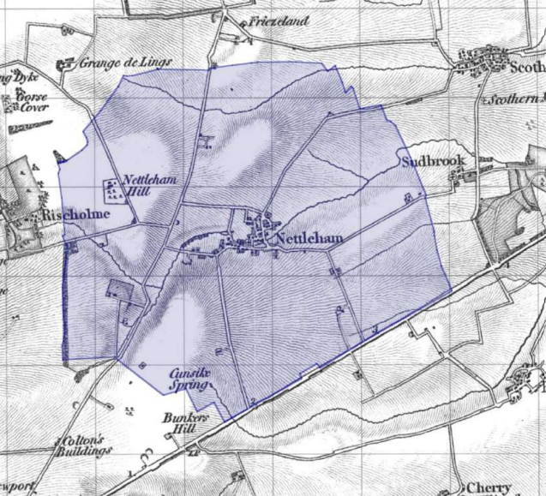
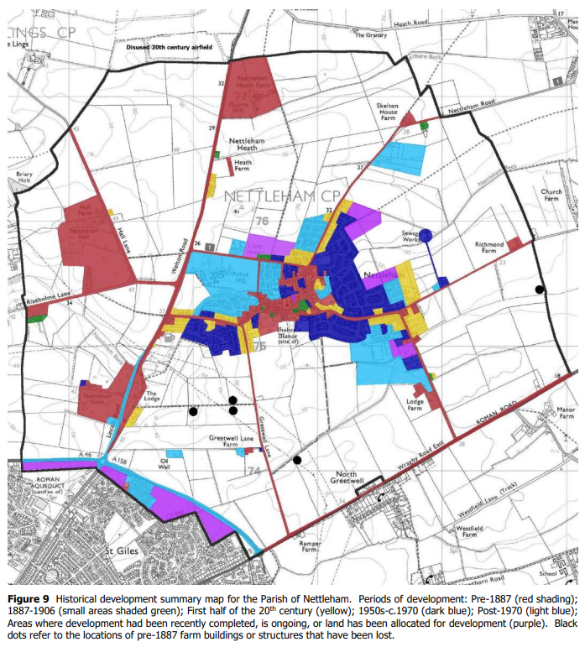
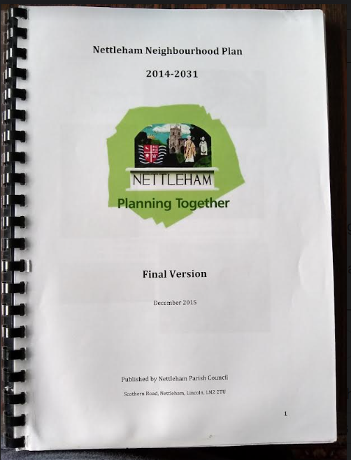
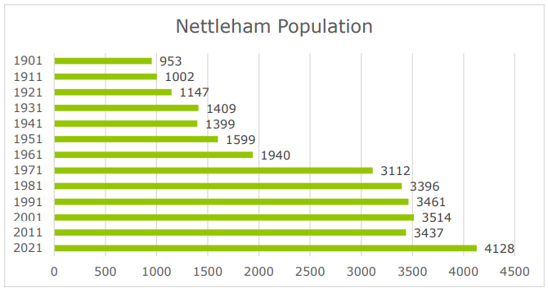
Nettleham Neighbourhood Plans

Slide 5
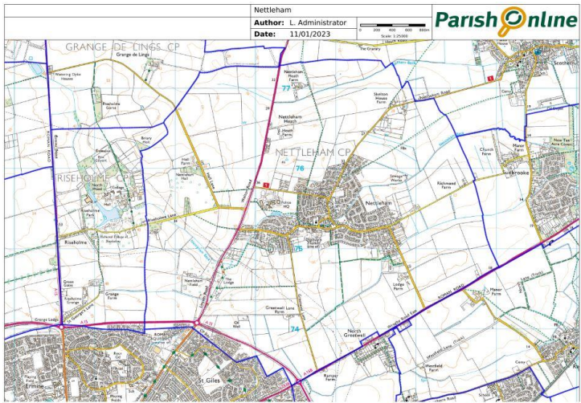
Nettleham Neighbourhood Plans

Slide 6
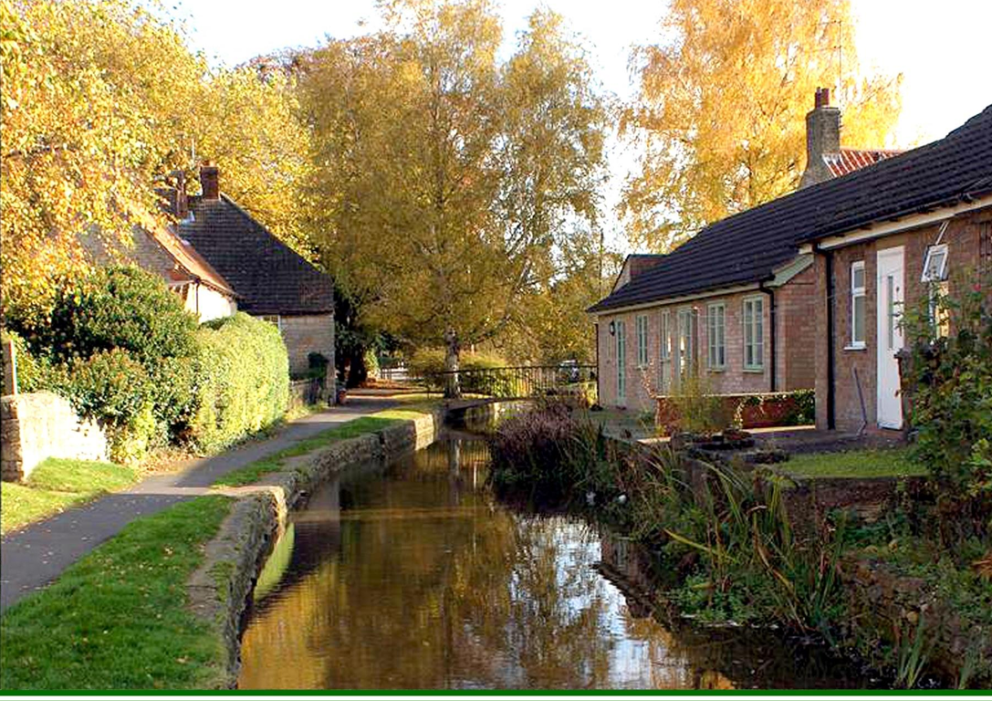
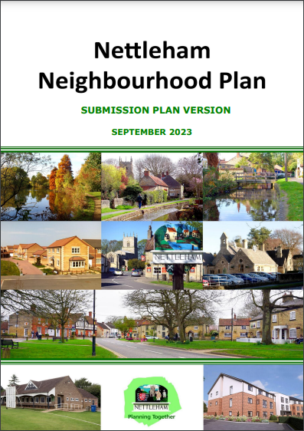
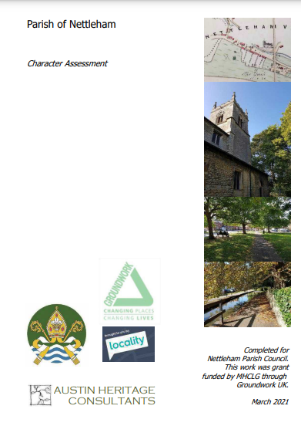
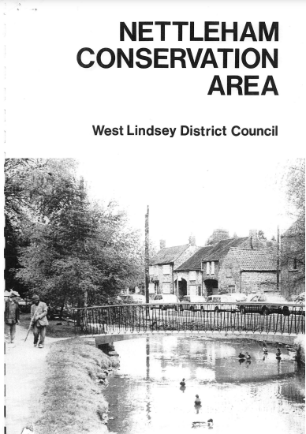
The NNP Review Process

Slide 7
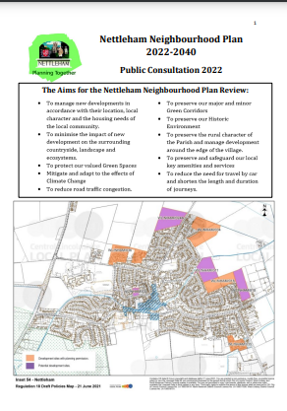
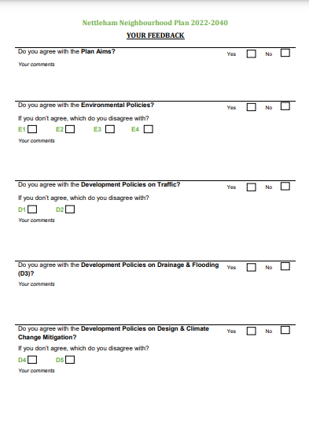
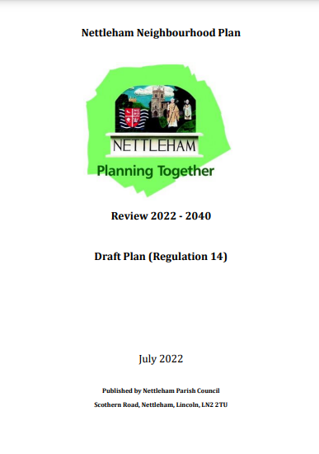
Public Consultation
Group constitution
Public Meetings
Public information displays & consultation
Information leaflets
Parish Council Website
Surveys
Nettleham Matters Articles
Statutory Bodies & interested parties

Slide 8
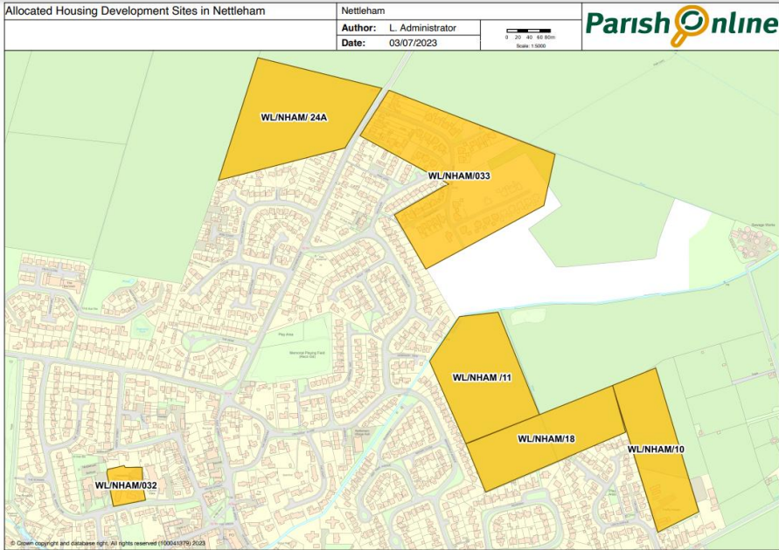
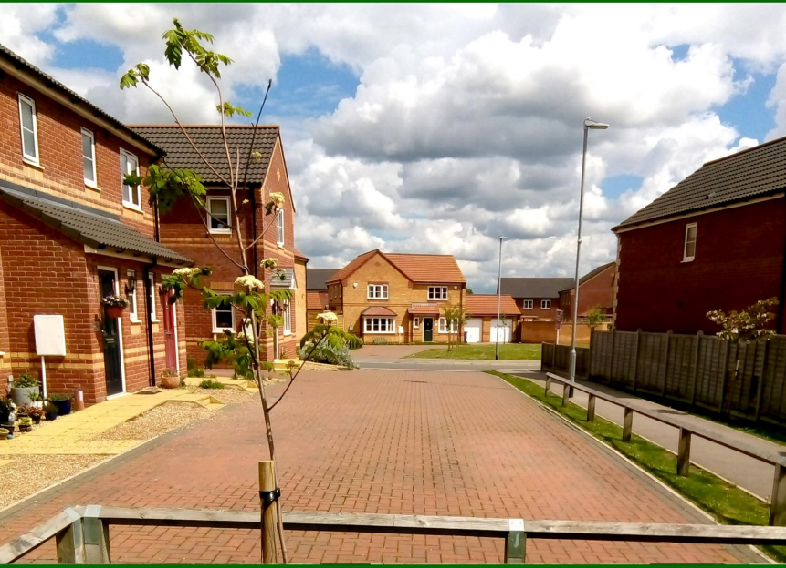
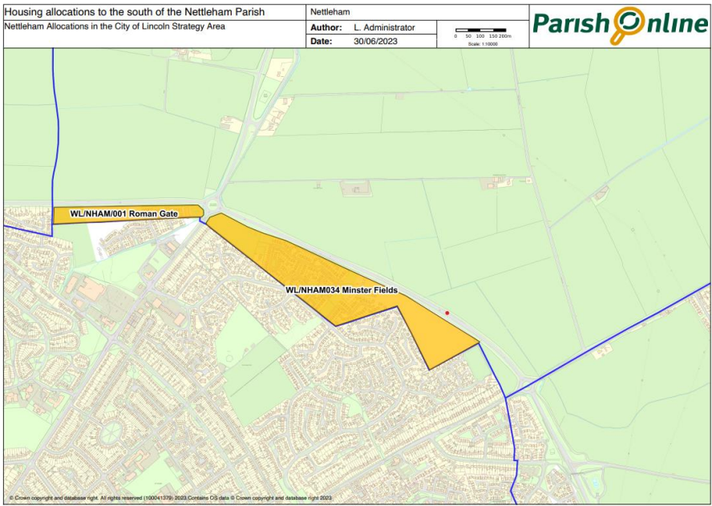
Nettleham Issues

Slide 9
Current situation
Submision version
Parish Council
Statutory Bodies & Interested Parties
Responses
Examination & Questions
Result & responses

Slide 10
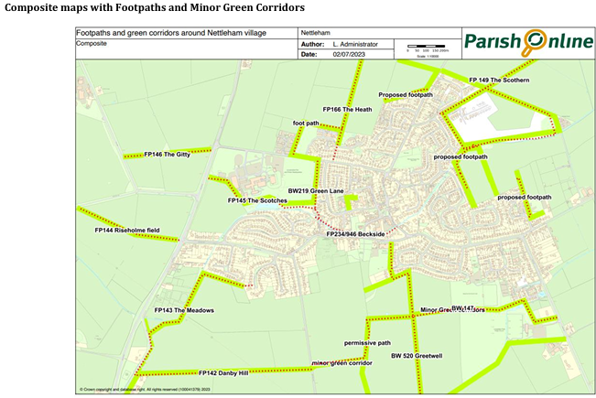
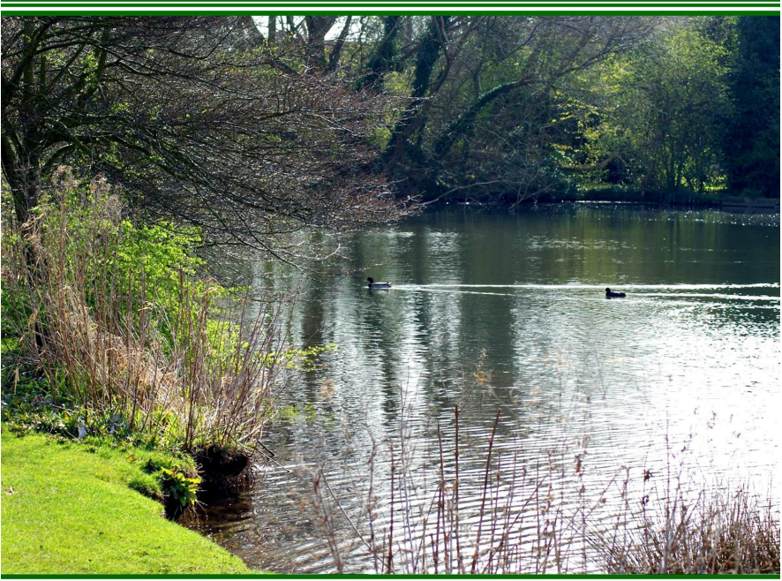
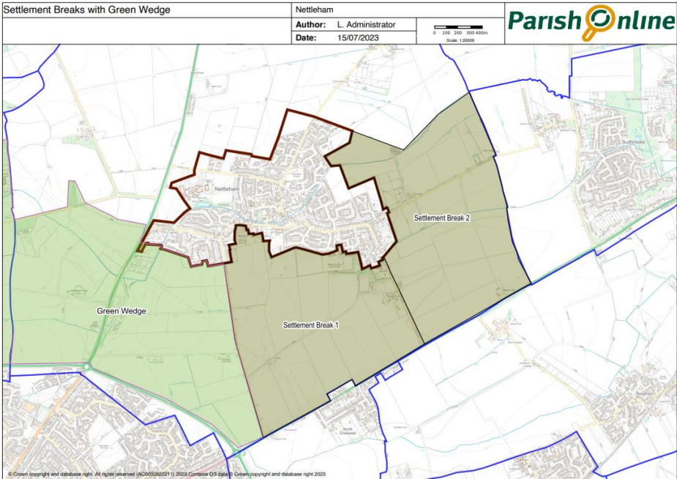
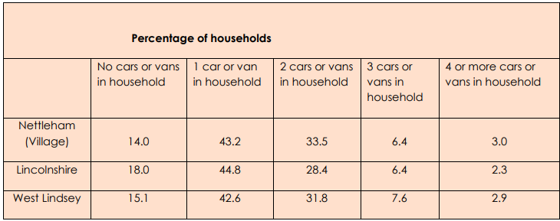
Nettleham Issues

Slide 11
Future & Adoption
Production of material for Nettleham residents
Referendum
Adoption (dependent on result)

